Slide 1
Level 6 Group 9
Blake Hewitt, Callam Mutton, Thomas Simmons, Quwaine Dantes-McPherson

Slide 2
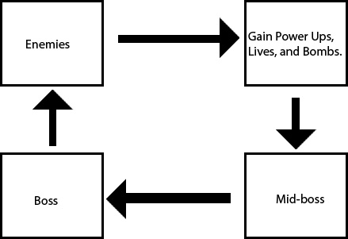
Bullet Hell Genre Overview
Demographic
Between the ages of 25 ~ 35, Jesse Schell states “hardcore gamers in this age bracket — that is, people for whom playing games is their primary hobby — are an important target market because they purchase a lot of games.” (The Art of Game Design, 2008, p.101).
According 2017 Video Game Trends and Statistics – Who’s Playing What and Why? Krista Lofgren states “The average age of gamers: 35” and “Male gamers: 59% and female gamers: 41%.”
Genre:
Shoot ‘em Up/Shmup (Bullet-Hell.)
4 Key of fun:
Hard Fun
Theme:
Rescue

Slide 3
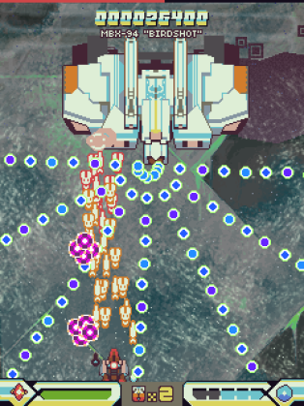
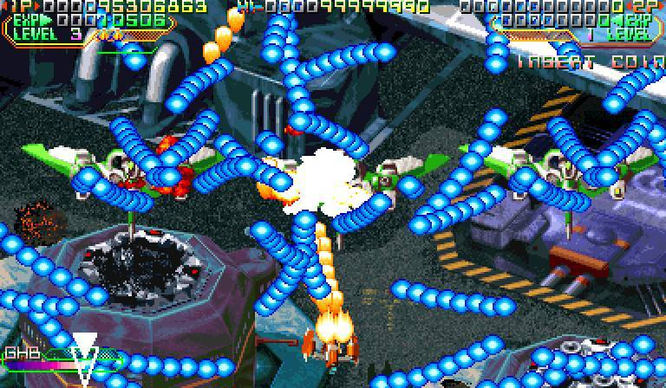
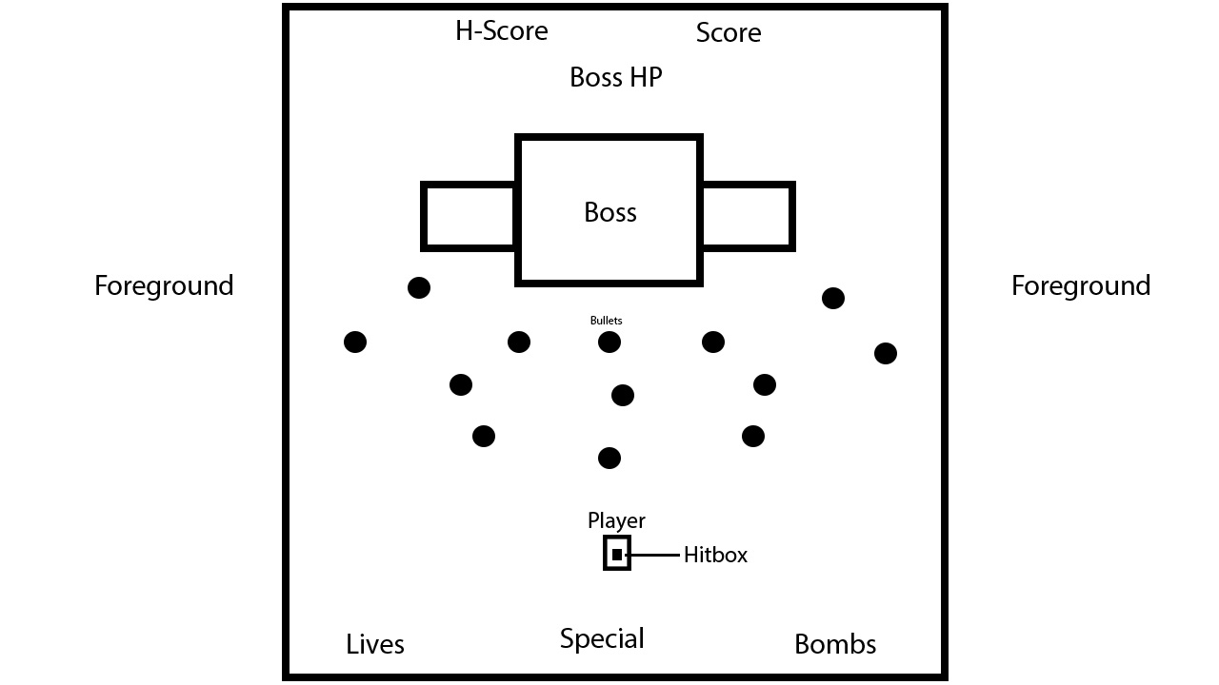
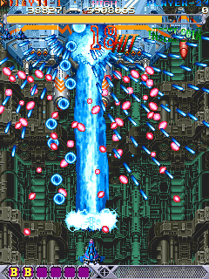
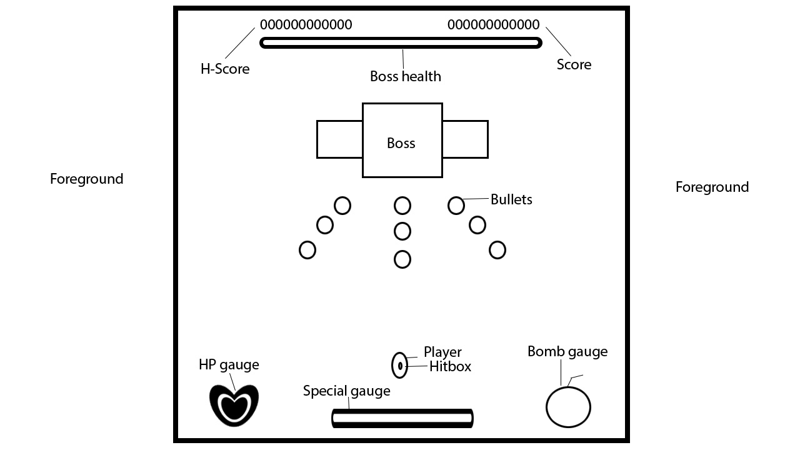
Concepts

Slide 4
Unique Selling Points
2.5D environments
Captivating narrative focused around the theme.
Charming art style/direction
Four types of challenging game difficulty

Slide 5
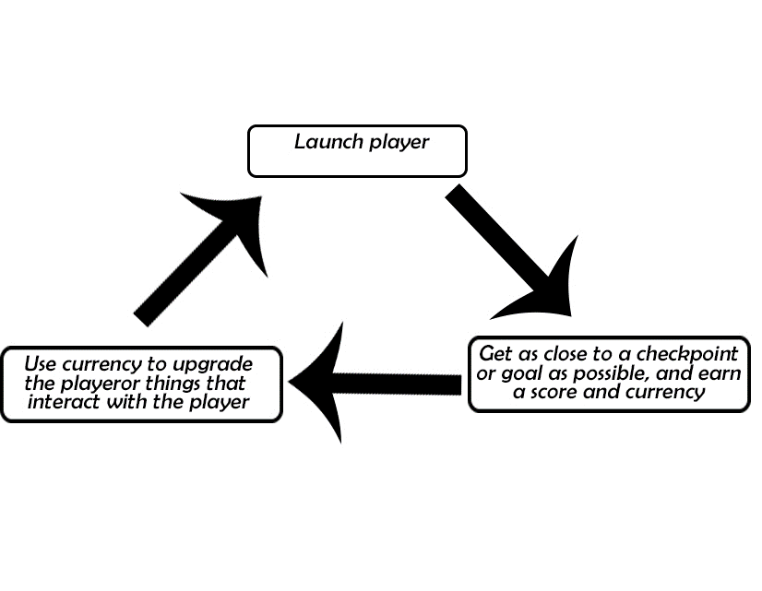
Toss Games Overview
Toss games revolve around throwing an object (living or otherwise) as far as possible.
Games in this genre range from ones that are entirely luck based, to ones where upgrades
And control over the object is present
Demographic
15-24-year-old males
based on Q4 of the UK games industry in 2016 (Luke, 2016) the largest demographic is 15-24-year-old males so it would be best to hit the largest target audience possible
4 Key of fun
Hard Fun, people fun

Slide 6
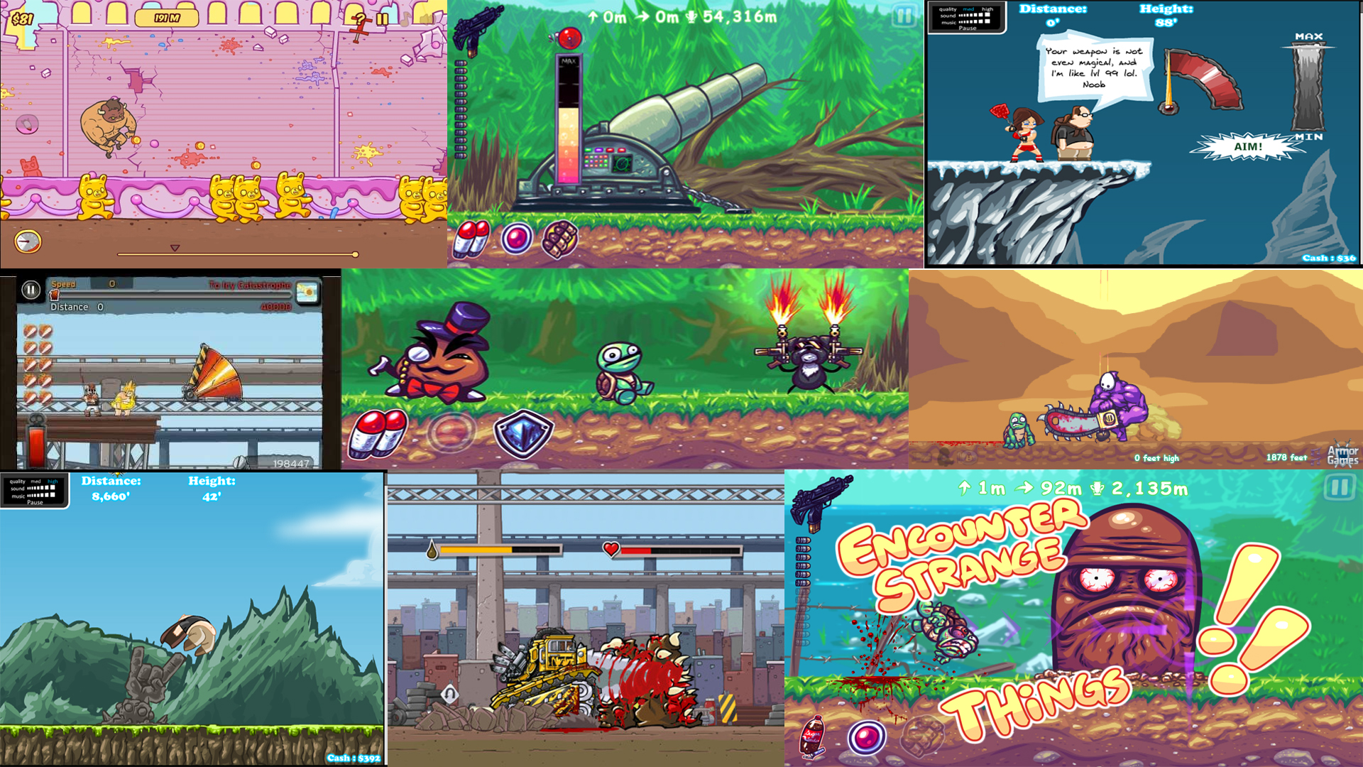
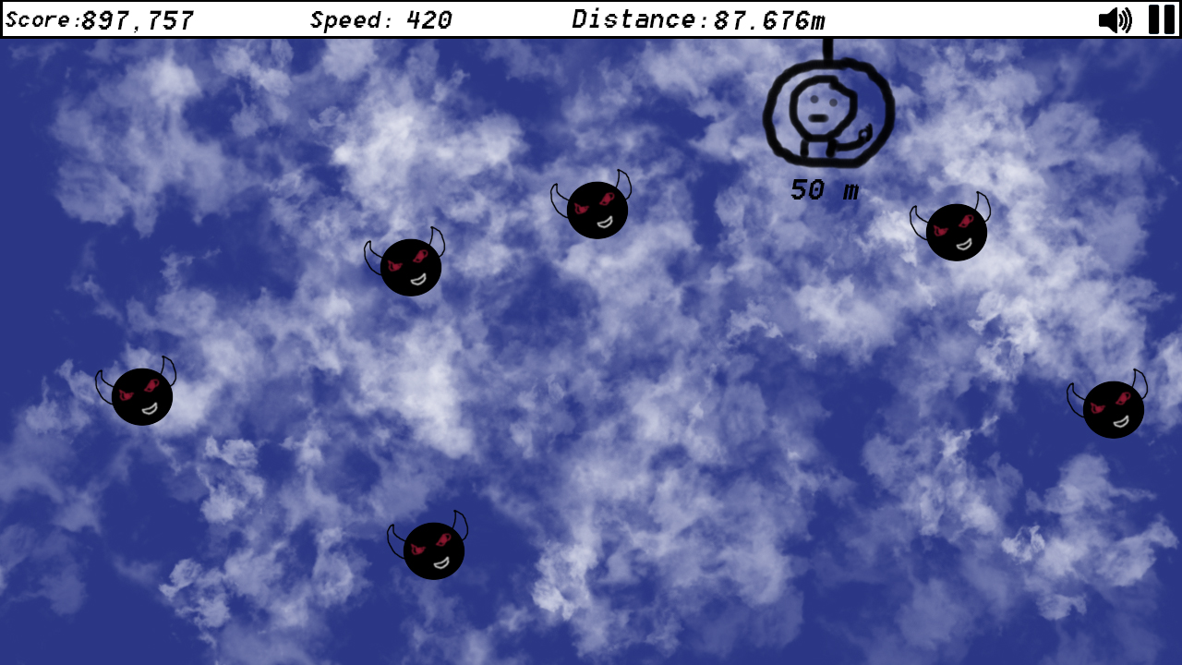
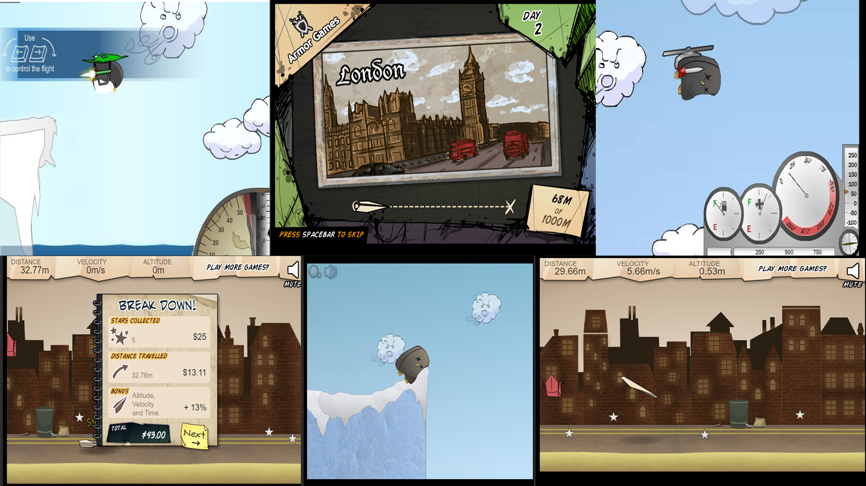
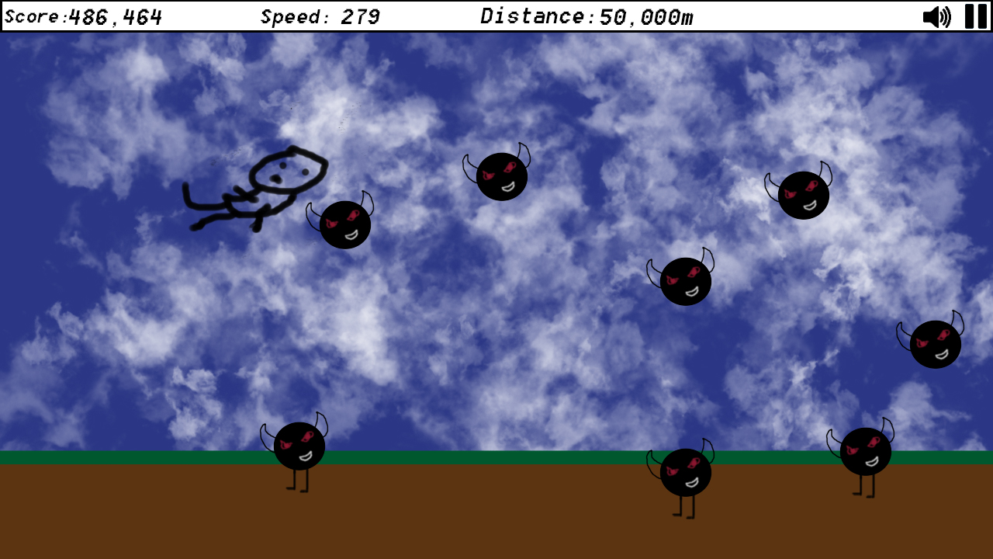
Concepts

Slide 7
Unique Selling Points
2.5D character and enemies to make them stand out from the background.
Mini games that allow the player to unlock special content
Achievements so it feels like there is a means to an end

Slide 8
Tower Defence Games Overview
The Tower Defence Genre is based on placing and upgrading “Towers” that automatically destroy enemies, with the goal of stopping the enemies from reaching the end of a track/path.
Core Loop:
Demographic:
The Hard Fun element of Tower Defence games, tends to be more appealing to male gamers, due to “men’s drive to compete”. (Fattah, 2002). As of 2017, 59% of gamers are male, which, the Hard Fun element of Tower Defence games will appeal to. (Statista, 2017).
Place Tower
Destroy Enemies
Earn Points/Currency

Slide 9
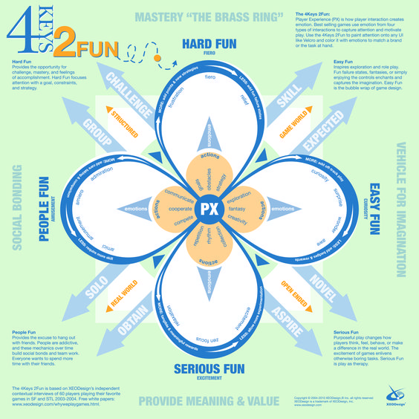
Keys Of Fun
Strategic Thinking, Overcome Obstacles & Achieve Goals
Frustration & Relief
Hard Fun
Repetitive Actions
Zen Focus
Serious Fun
(Lazzaro, 2010).

Slide 10
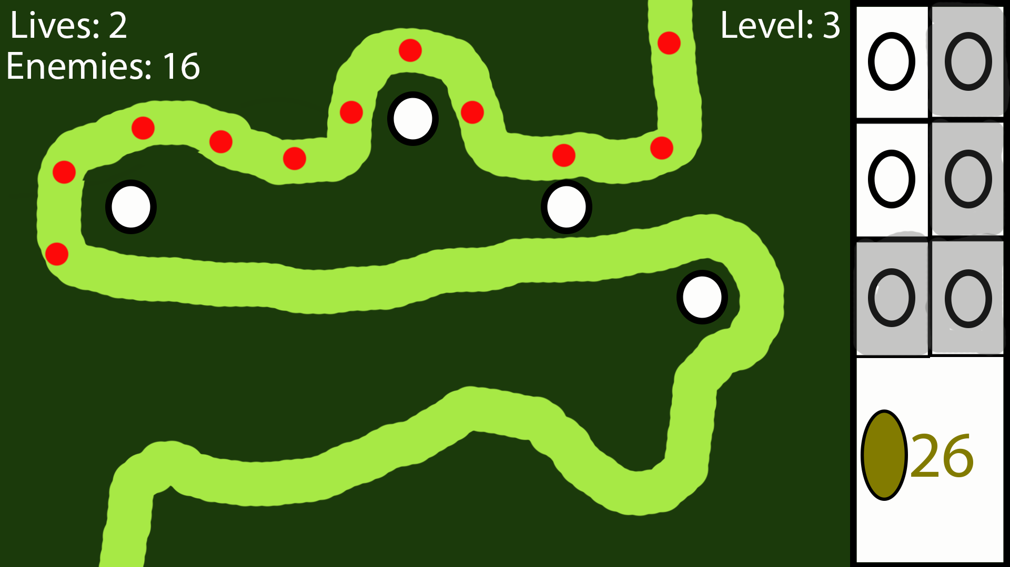
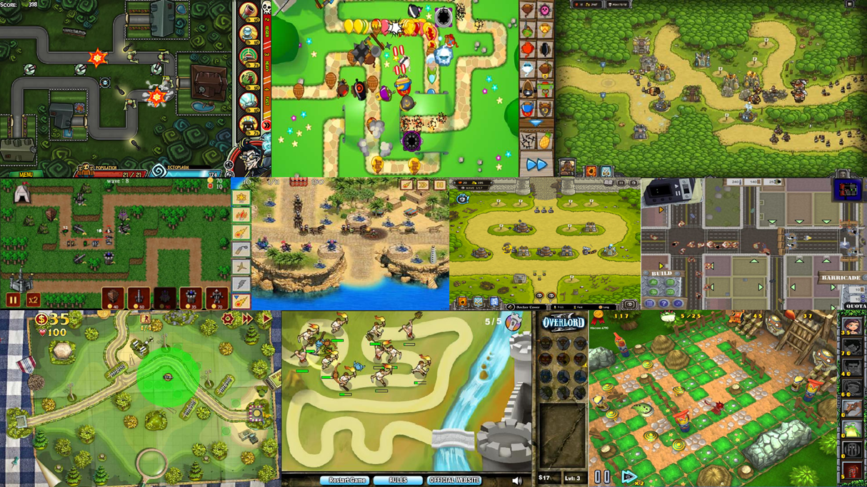
Concept

Slide 11
Unique Selling Points
3D or 2.5D enemies, environments and towers.
A theme tied to an overarching narrative.
Combination with elements from other genres

Slide 12
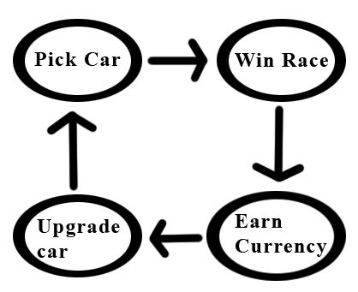
Racing Games Overview
The racing type game genre gets the player to control the movement of vehicles to help avoid, collect and win an race. This results in the player acquiring rewards like in game currency, upgrades and all new vehicles.
Core Loop:
Target Demographic:
Male and Female gamers aged between 25-35 who play on their phones/tablets. This is due to The average age of gamers in the UK is 30 and 35 in the US. The ratio of male to female gamers is 52:48 and Mobile apps are more profitable with $30.3 billion in 2015.

Slide 13
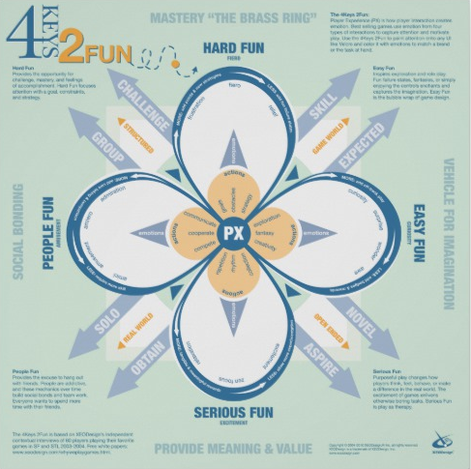
Keys of Fun
These games have an element of strategy and reaching a goal causing the player to feel the emotions linked with Hard Fun.
Also these games tend to have a Multiplayer element or the ability for two players to play on one screen. This links to the player/s competing or co-operating which are emotions linked to People Fun.

Slide 14
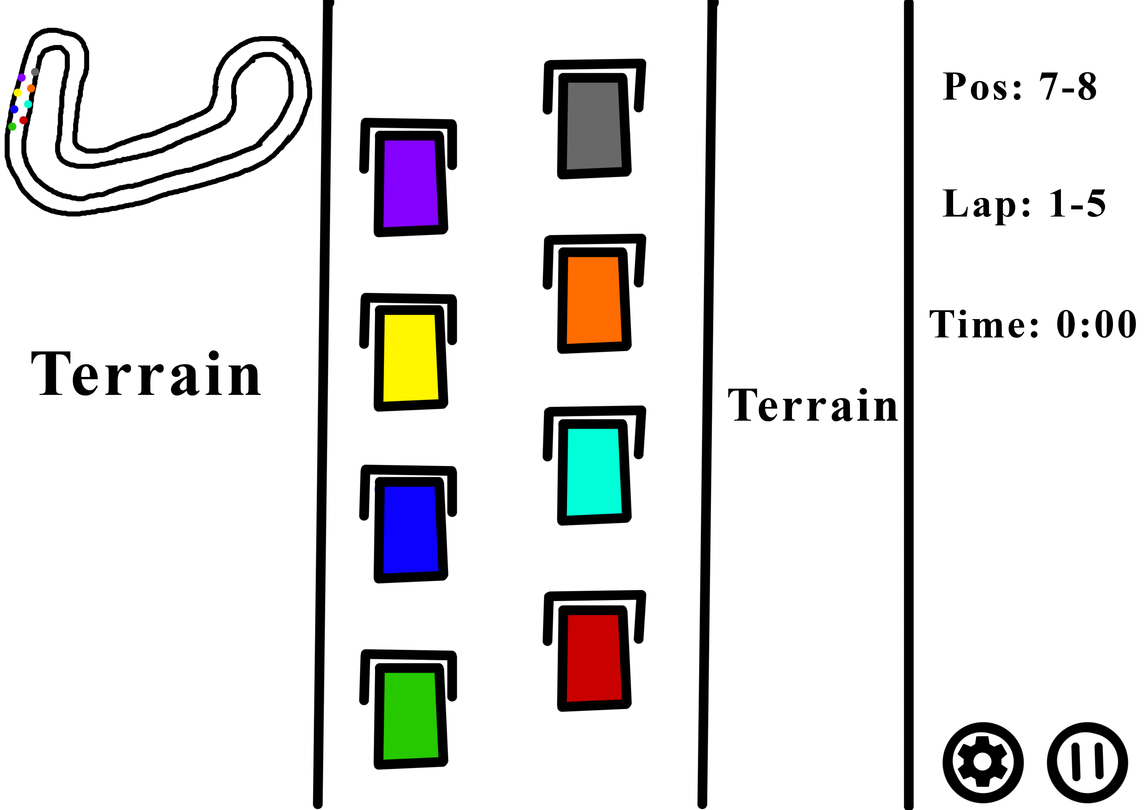
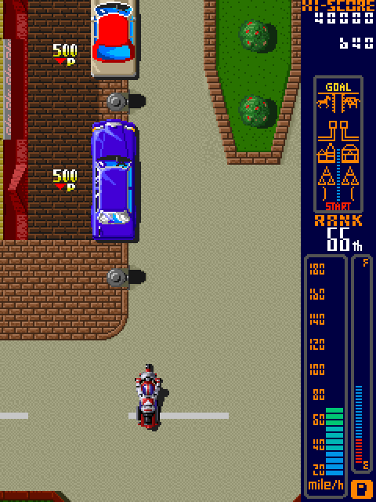
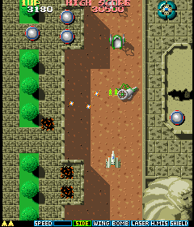
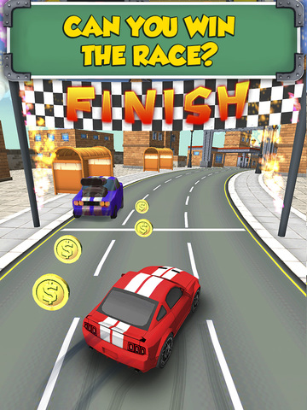

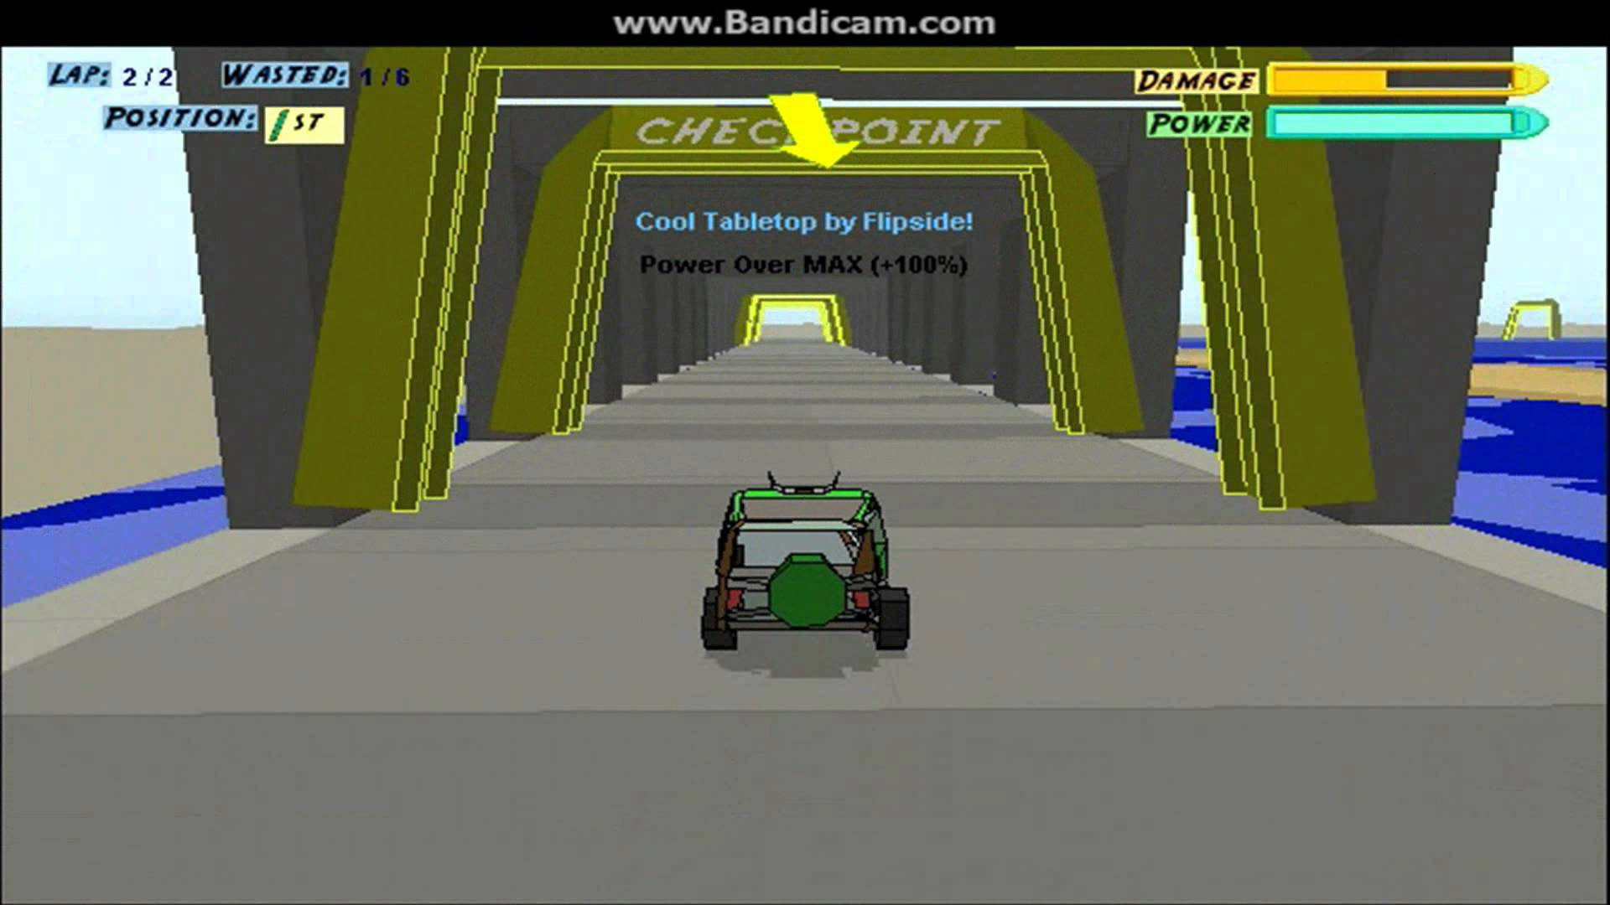
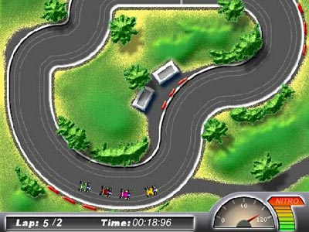
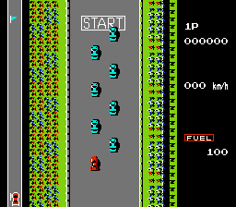
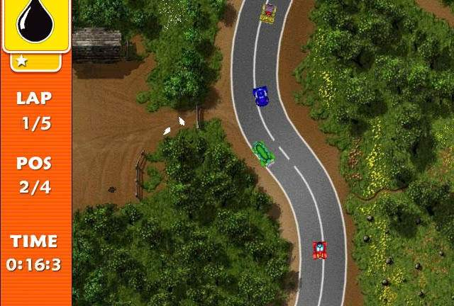
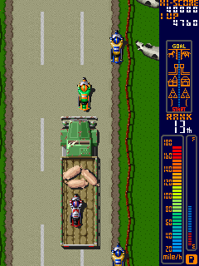
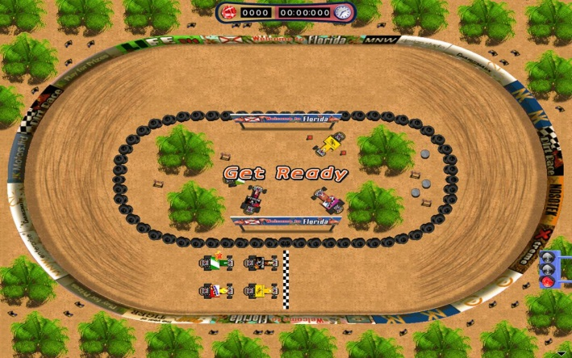
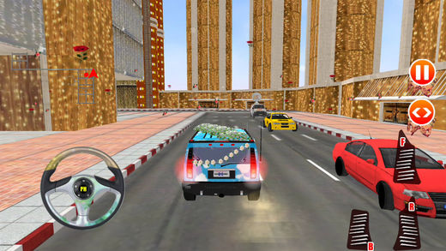
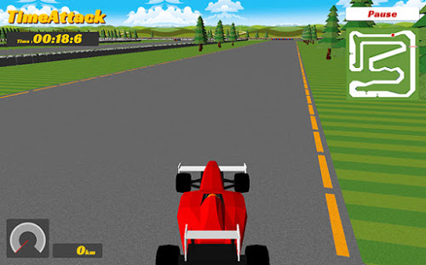
Concepts

Slide 15
Unique Selling Points
The ability for the players to use tracks that actually exist in the real world (Brands Hatch & Silverstone)
Being able to upgrade cars and strengthen their performance
2.5D environments
Possible difficulty levels

